Slide 1

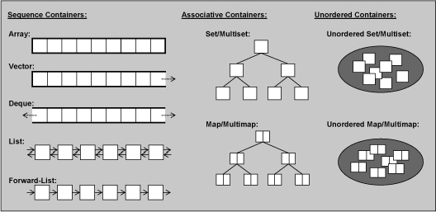
CPSC 131 – Data Structures
Singly and Doubly Linked List Abstract Data Types
Professor T. L. Bettens
Spring 2023

Slide 2
Concepts & Interface
Jusuttis, The C++ Standard Library
6.2. Containers
7.1. Common Container Abilities and Operations
7.6. Forward (Singly Linked) Lists
7.6.4. Examples of Using Forward Lists
7.5. (Doubly Linked) Lists
7.5.4. Examples of Using Lists
CPPReference.com
Containers library
std::forward_list
std::list
Implementation Examples
SinglyLinkedList
DoublyLinkedList
Student

Slide 3
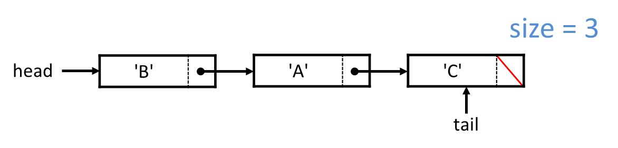
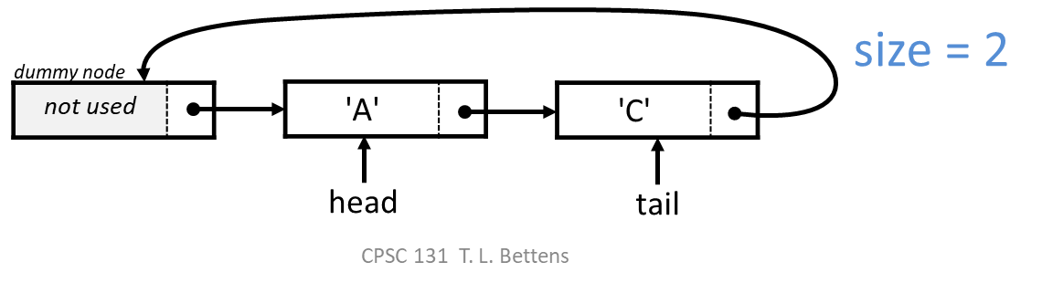
Linked List Abstract Data Type
Definitions:
Node - an object containing data and link(s) to adjacent node(s)
Head - the first node in the list
Tail - the last node in the list
Null-terminated - a list whose link in the last node is null
Circular - a list whose link in the last node is the first node

Slide 4
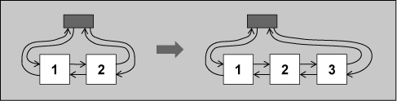
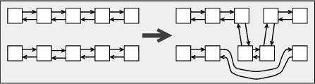


Linked List Abstract Data Type Two flavors, Singly and Doubly Linked
Sentinel (Dummy) Nodes, or not
Singly Linked List
Doubly Linked List
Can move only forward
Can insert and delete the “next” element, never the “current” element
Can move in both directions
Can delete “current” element
Can insert before or after “current”

Slide 5
Linked List Abstract Data Type The Abstraction - What can I do to a Linked List?
SinglyLinkedList
DoublyLinkedList
Construct, destruct, assign
Copy, compare
Iterate
Access elements
front, back
Query
empty, size
Operations
Insert, erase, clear
push_front, push_back, pop_front, pop_back

Slide 6

Singly Linked List Implementation Example
main.cpp includes both
SinglyLinkedList.hpp and Student.hpp
SinglyLinkedList.hpp conditionally includes either
SinglyLinkedList_null_terminated.hxx or
SinglyLinkedList_circular.hxx
Student.cpp includes only
Student.hpp
SinglyLinkedList_circular.hxx
SinglyLinkedList_null_terminated.hxx
SinglyLinkedList.hpp
Student.hpp
main.cpp
Student.cpp

Slide 7
In Class Sketching Activity
Using the Implementation Examples, for each of the major operations of Singly Linked Lists, step through the code and sketch the resulting structure

Slide 8
Doubly Linked List Implementation Example
main.cpp includes both
DoublyLinkedList.hpp and Student.hpp
DoublyLinkedList.hpp conditionally includes either
DoublyLinkedList_null_terminated.hxx or
DoublyLinkedList_circular.hxx
Student.cpp includes only
Student.hpp
DoublyLinkedList_circular.hxx
DoublyLinkedList_null_terminated.hxx
DoublyLinkedList.hpp
Student.hpp
main.cpp
Student.cpp

Slide 9
In Class Sketching Activity
Using the Implementation Examples, for each of the major operations of Doubly Linked Lists, step through the code and sketch the resulting structure

Slide 10
Analysis of the Vector Abstract Data Type Complexity Analysis (1)
Function | Analysis – std::forward_list<T> (Singly Linked List) | Analysis – std::list<T> (Doubly Linked List)
at() | Not available | Not available
size() | O(n) std::forward_list<T> calculates size on demand | same
empty() | O(1) | same
clear() | O(n) All elements are destroyed and size set to zero | same

Slide 11
Analysis of the Vector Abstract Data Type Complexity Analysis (2)
Function | Analysis – std::forward_list<T> (Singly Linked List) | Analysis – std::list<T> (Doubly Linked List)
push_back() | Not available std::forward_list<T> has no tail pointer | O(1) has tail pointer
erase() | O(1) assumes you have erasure point Can erase only after erasure point | O(1) assumes you have erasure point Can erase only before erasure point
splice | Not available std::forward_list<T> has no tail pointer | O(1)

Slide 12
Analysis of the Vector Abstract Data Type Complexity Analysis (3)
Function | Analysis – std::forward_list<T> (Singly Linked List) | Analysis – std::list<T> (Doubly Linked List)
insert() | O(1) assumes you have insertion point Can insert only after insertion point | O(1) assumes you have insertion point Can insert only before insertion point
default construction | O(1) creates an empty container | same
Equality C₁ == C₂ | O(n) | same

Slide 13
Analysis of the Vector Abstract Data Type Complexity Analysis (4)
Function | Analysis – std::forward_list<T> (Singly Linked List) | Analysis – std::list<T> (Doubly Linked List)
push_front | O(1) | same
resize | O(n) | same
find | O(n) linear search from begin() to end() (i.e. head to tail) | same

Slide 14
Analysis of the Vector Abstract Data Type Complexity Analysis (5)
Function | Analysis – std::forward_list<T> (Singly Linked List) | Analysis – std::list<T> (Doubly Linked List)
Visit every element e.g. print() | O(n) Visiting every node from begin() to end() | same
Visit in reverse e.g. print_reverse() | not possible | O(n) Visiting every node from rbegin() to rend() Direction doesn’t matter

Slide 15
Circular Singly Linked Lists w/one dummy node
A singly linked list is a concrete data structure consisting of a sequence of nodes
Each node stores
Data element
link to the next node
next
data
node
head
tail
pointer/link
dummy node
Not
used
A
B
C
D
pointer/link hopping

Slide 16
Null-Terminated Singly Linked Lists
A singly linked list is a concrete data structure consisting of a sequence of nodes
Each node stores
Data element
link to the next node
next
data
node
head
tail
pointer/link
A
B
C
D
∅
pointer/link hopping

Slide 17
Inserting at the Head
Allocate and populate a new node
Have new node point to old head
Update head to point to new node
Head
Tail
London
Rome
Seattle
Toronto

Slide 18
Deleting at the Head
Update head to point to the next node in the list
Delete the former first node
Head
Tail
London
Rome
Seattle
Toronto

Slide 19
Inserting at the Tail
Allocate and populate a new node
Have new node point to whatever the tail node pointed to, namely nullptr
Point the old Tail node to the new node
Update tail to point to new node
Head
Tail
Rome
Seattle
Toronto
London

Slide 20
Draw data structure for this code
prepend == push_front
removeFront == pop_front
SLinkedList<string> ds;
cout << ds.size();
ds.prepend("road");
ds.prepend("winding");
cout << ds.front();
ds.prepend("and");
ds.removeFront();
ds.prepend("long");
cout << ds.front();
Head
Head
winding
road
Head
and
winding
road
Head
winding
road
Head
long
winding
road

Slide 21
Draw data structure for this code
append == push_back
removeFront == pop_front
SLinkedList<string> ds;
cout << ds.size();
ds.append("road");
ds.append("winding");
cout << ds.front();
ds.append("and");
ds.removeFront();
ds.append("long");
cout << ds.front();
Head
Head
road
winding
Head
road
winding
and
Head
winding
and
Head
winding
and
long

Slide 22
Nodes
To create a linked list using dynamic storage, we need a class which has two data members:
one to hold information
one to point to another object of the same class

Slide 23
Singly Linked List Node
template<typename T>
struct SinglyLinkedList<T>::Node
{
Node() = default;
Node( T value ) : _data{ std::move(value) } {}
T _data = T{};
Node * _next = nullptr;
};
Null-Terminated
SLL Node definition
next
data
∅
Circular
SLL Node definition
template<typename T>
struct SinglyLinkedList<T>::Node
{
Node() = default;
Node( T value ) : _data{ std::move(value) } {}
T _data = T{};
Node * _next = this;
};
next
data

Slide 24
Picture of a Node
SLinkedList<int>::Node node(5);
node.next = nullptr;
5
data
next

Slide 25
Creating a node as a dynamic variable
SLinkedList<int>::Node * pointer;
pointer = new SLinkedList<int>::Node(5)
5
*pointer
pointer

Slide 26
Accessing the fields of the node
(*pointer).data
(*pointer).next
(*pointer).data
5
(*pointer).next
pointer

Slide 27
Accessing the fields of the node
(*pointer).data can also be written as pointer->data
(*pointer).next can also be written as pointer->next
(*pointer).data
5
(*pointer).next
pointer

Slide 28
Accessing the fields of the node
pointer->data == 5
pointer->next == nullptr
pointer->data
5
pointer->next
pointer

Slide 29
Review: delete
What does
delete pointer;
do?
5
pointer

Slide 30

Answer
It deletes the node, but
leaves the pointer dangling.
5
*pointer
pointer
pointer

Slide 31
What about a linked list?
Since the next field can point to another node, we can link nodes together like this:
8
3
2
7
head

Slide 32
Creating a linked list
Start out with two NULL pointers to NodeType.
Code for this??
SLinkedList<int>::Node *pointer = nullptr;
SLinkedList<int>::Node *head = nullptr;
pointer
head

Slide 33
Creating a linked list
Now create a new SinglyLinkedNode using pointer.
Code for this??
pointer = new SLinkedList<int>::Node(5);
5
pointer
head

Slide 34
Creating a linked list
Now what happens if we do
pointer->next = head;
head contains nullptr, which gets copied to pointer->next
5
pointer
head

Slide 35
Creating a linked list
Now we want head to point to the new node,
i.e. head should contain the address of the new node.
What already has that address? pointer
so head = pointer will copy the address to head.
5
pointer
head

Slide 36
Creating a linked list
Putting the code together:
pointer = new SLinkedList<int>::Node(5);
pointer->next = head;
head = pointer;

Slide 37
Going from code to picture
Now try seeing what happens if we repeat the same code with data now set to 8, starting with this picture.
5
pointer
head

Slide 38
Going from code to picture
pointer = new SLinkedList<int>::Node(8);
pointer->next = head;
head = pointer;
8
5
pointer
head

Slide 39
Going from code to picture
pointer = new SLinkedList<int>::Node(8);
pointer->next = head;
head = pointer;
8
5
pointer
head

Slide 40
Going from code to picture
pointer = new SLinkedList<int>::Node(8);
pointer->next = head;
head = pointer;
8
5
pointer
head

Slide 41
So the following code will go from
pointer = new SLinkedList<int>::Node(8);
pointer->next = head;
head = pointer;
5
pointer
head

Slide 42
to this, i.e. insert a node at the front
void prepend( const Data_t & element );
pointer = new SLinkedList<int>::Node(8);
pointer->next = head;
head = pointer;
5
8
5
pointer
head
pointer
head

Slide 43
Singly Linked List and Doubly Linked List
What if want to access data in reverse order?
head
tail
∅
Node:
element
next pointer
- previous pointer
Linked List:
length
Head
Tail
next
prev
next
data
data
node
node

Slide 44
Doubly Linked List Node
template<typename T>
struct DoublyLinkedList<T>::Node
{
Node() = default;
Node( const T value ) : _data( std::move(value) ) {}
T _data = T{};
Node * _next = nullptr;
Node * _prev = nullptr;
};
Null-Terminated
DLL Node definition
prev
next
∅
data
∅
Circular
DLL Node definition
template<typename T>
struct DoublyLinkedList<T>::Node
{
Node() = default;
Node( T value ) : _data( std::move(value) ) {}
T _data = T{};
Node * _next = this;
Node * _prev = this;
};
prev
next
data

Slide 45
Circular Doubly Linked Lists w/one dummy node
Key ideas
Keep a previous pointer in addition to a next pointer at every node
Keep a dummy node at the head of circular list
“Dummy
node”
a
b
c
head
tail

